Slide 1

SVPM'S COE,MALEGAON(Bk) BARAMATI

Slide 2
Presentation On Leaf Disease Detection and Recognition Using CNN
Presented By :
Ms. OMINI MAHENDRA JADHAV :- 323
Mr.. ROHIT HARISHCHANDRA PAWAR :- 354
Mr. MANMANTH RAJENDRA MENGI :- 349
Ms. MADHURI DEVIDAS GIRAMKAR :- 319
Guided By
Prof S.S.Nimbalkar
Department Of Computer Engineering

Slide 3
PROBLEM STATEMENT
In Agriculture field all farmers facing the problem of leaf disease. Detecting leaf disease the main struggle of a farmar is that the field that he is growing up should be healthy and any disease and that's what we have considered and been working on, we are using the new technology that ensures the 100% health of the plants and alerts if any disease is found with exact accuracy
Basically it uses the CNN gets the images and finds if the plant is affected with any disease.

Slide 4
Introduction
The primary occupation in India is agriculture. India ranks second in the agricultural output worldwide. Here in India, farmers cultivate a great diversity of crops. Various factors such as climatic conditions, soil conditions, various disease, etc. Affect the production of the crops. The existing method for plants disease detection is simply naked eye observation which requires more man labor, properly equipped laboratories, expensive devices ,etc. And improper disease detection may led to inexperienced pesticide usage that can cause development of long term resistance of the pathogens, reducing the ability of the crop to fight back. The plant disease detection can be done by observing the spot on the leaves of the affected plant. The method we are adopting to detect plant diseases is image processing using Convolution neural network(CNN).

Slide 5
DOMAIN- IMAGE PROCESSING
Image processing is a method to perform some operations on an image, in order to get an enhanced image or to extract some useful information from it. It is a type of signal processing in which input is an image and output may be image or characteristics/features associated with that image. Nowadays, image processing is among rapidly growing technologies. It forms core research area within engineering and computer science disciplines too.
Image processing basically includes the following three steps:

Slide 6
STEP'S
Importing the image via image acquisition tools;
Analyzing and manipulating the image;
Output in which result can be altered image or report that is based on image analysis.

Slide 7
OBJECTIVE
We can reduce the attack of pests by using proper pesticides and remedies .We can reduce the size of the images by proper size reduction techniques and see to it that the quality is not compromised to a great extent. We can expand the projects of the earlier mentioned authors such that the remedy to the disease is also shown by the system . The main objective is to identify the plant diseases using image processing. It also, after identification of the disease, suggest the name of pesticide to be used. It also identifies the insects and pests responsible for epidemic. Apart from these parallel objectives, this drone is very time saving. The budget of the model is quite high for low scale farming purposes but will be value for money in large scale farming. It completes each of the process sequentially and hence achieving each of the output. Thus the main objectives are: 1) To design such system that can detect crop disease and pest accurately. 2) Create database of insecticides for respective pest and disease. 3) To provide remedy for the disease that is detected.

Slide 8
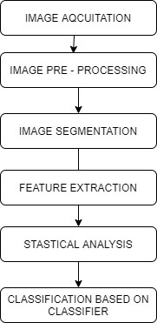
System Architecture​

Slide 9
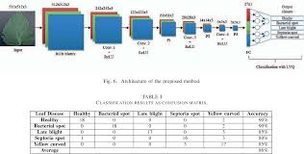
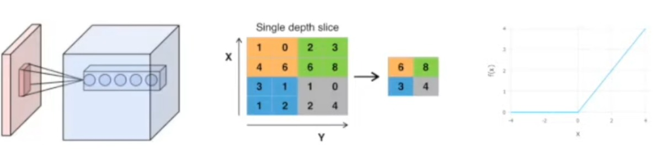
CONVOLUTIONAL NEURAL NETWORK
CONVOLUTIONAL LAYER
POOLING LAYER
RELU LAYER
FULLY CONNECTED LAYER

Slide 10
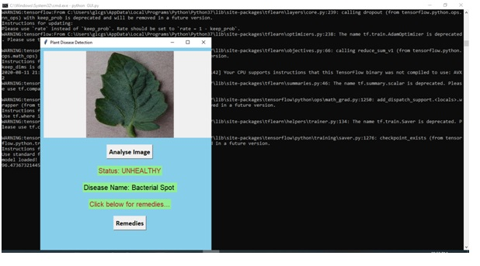
TAKING INPUT OF LEAF IMAGE.
TO FIND OUT DISEASE OF LEAF IF ANY .

Slide 11
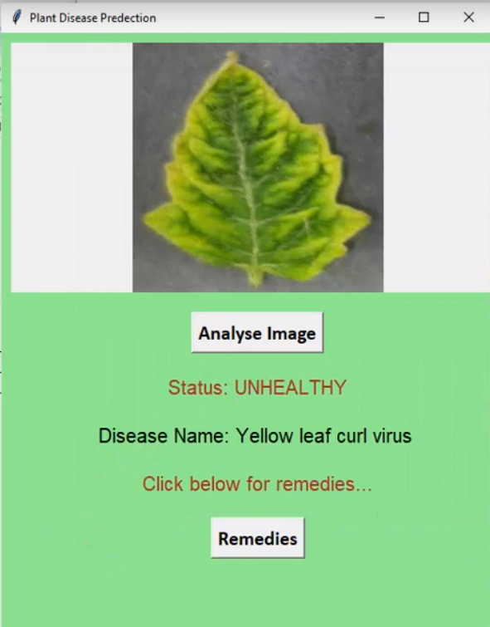

Slide 12
Conclusion
To prevent losses, small holder farmers are dependent on timely and accurate crop disease diagnosis. Plant Diseases are major food threats that should have to overcome before it leads to further loss of the entire field. But, often framers unable to distinguish between similar symptoms but ace different diseases. This will mislead to wrong or overdosage of fertilizers. Here, we employ Convolutional Neural Network(CNN) called Deep Learning Algorithms to reduce this loss and guide farmers with video lessons.

Slide 13
References
[1] M. Hunter, R. Smith, M. Schipanis, L. Atwood and D. Mortensen, "Agriculture in 2050: Recalibrating Targets for Sustainable Intensification", Bioscience, vol. 67, no. 4, pp. 386-391, 2017. Available: 10.1093/bosc/bix010
[2] . https://towardsdatascience.com/crop-plant-disease-identification-using-mobile-app-aef821d1a9bc
[3] . https://www.mdpi.com/2223-7747/8/11/468/htm
[4]. Plant Disease Detection Using Image Processing | IEEE ...

